Slide 1
(Alexandre.Lloyd@oecd.org)
OECD work on homelessness
Data on homelessness country notes and forthcoming toolkit to combat homelessness
FEANTSA Forum 2024
Vienna - 18 June 2024
Ali Bargu, Policy Analyst/Economist, Ali.Bargu@oecd.org

Slide 2
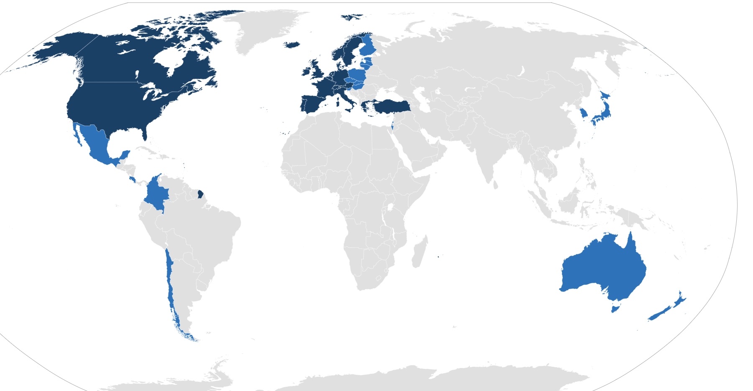
The OECD is an international organisation that works towards creating „Better policies, for better lives“
Die OECD-Zone: 38 Länder
What does the OECD do?
Collect comparable data across countries
Exchange of experiences
Draft guidelines and policy recommendations for governments

Slide 3
Three OECD deliverables to improve the measurement of and policy responses to homelessness.
Monitoring framework
to facilitate understanding, comparison & assessment of the extent of homelessness
in OECD and EU countries
Country notes
for all OECD + EU countries with homeless data, definitions, data collection approaches, and selected information on strategies
Policy toolkit
to help governments develop effective homeless strategies

Slide 4
Data on Homelessness Country notes

Slide 5
OECD Data on Homelessness Country notes
The OECD has developed 41 Data on Homelessness country notes, with the following information:
Official statistical definitions of homelessness
Detailed data on people experiencing homelessness, disaggregated by gender and ETHOS Light category
Legal frameworks to collect data on homelessness
National homelessness strategies
Detailed information on approaches to collect data on homelessness,
The Data on Homelessness country notes can be accessed at : https://www.oecd.org/social/homelessness-country-notes.htm
Country notes
for all OECD + EU countries with homelessness data, definitions, data collection approaches, and selected information on strategies
The OECD is currently a developing a set of city notes, based on the responses to the Questionnaire on Affordable and Social Housing (QuASH 2023).

Slide 6
Homelessness rates vary widely across countries.
HC3.1.1. People experiencing homelessness who are living rough (ETHOS Light 1) or staying in emergency accommodation or accommodation for the homeless (ETHOS Light 2 & 3), per 10,000 people, 2023 or latest year
A. Point-in-time data
Notes: 1. Data for the United Kingdom (England) refer to the number of households experiencing homelessness per 10 000 households for ETHOS Light 2 and 3; data also include people enumerated in the Rough Sleeping Snapshot (ETHOS 1). 2. Data for France exclude people staying in temporary accommodation for asylum seekers (under ETHOS 2 and 3) to facilitate cross-country comparison.
Source: OECD Affordable Housing Database (2024), indicator HC3.1, People experiencing homelessness, https://www.oecd.org/housing/data/affordable-housing-database/housing-conditions.htm.

Slide 7
Women typically account for a smaller share of people experiencing homelessness in national statistics, driven in part by how homelessness is defined and counted.
HC3.1.2. Share of women as a percentage of people experiencing homelessness, by ETHOS Light definition, point-in-time vs. flow data, 2023 or latest year
Point-in-time data
Flow data
Source: OECD Affordable Housing Database (2024), indicator HC3.1, People experiencing homelessness, https://www.oecd.org/housing/data/affordable-housing-database/housing-conditions.htm.

Slide 8
FORTHCOMING toolkit to combat homelessness

Slide 9
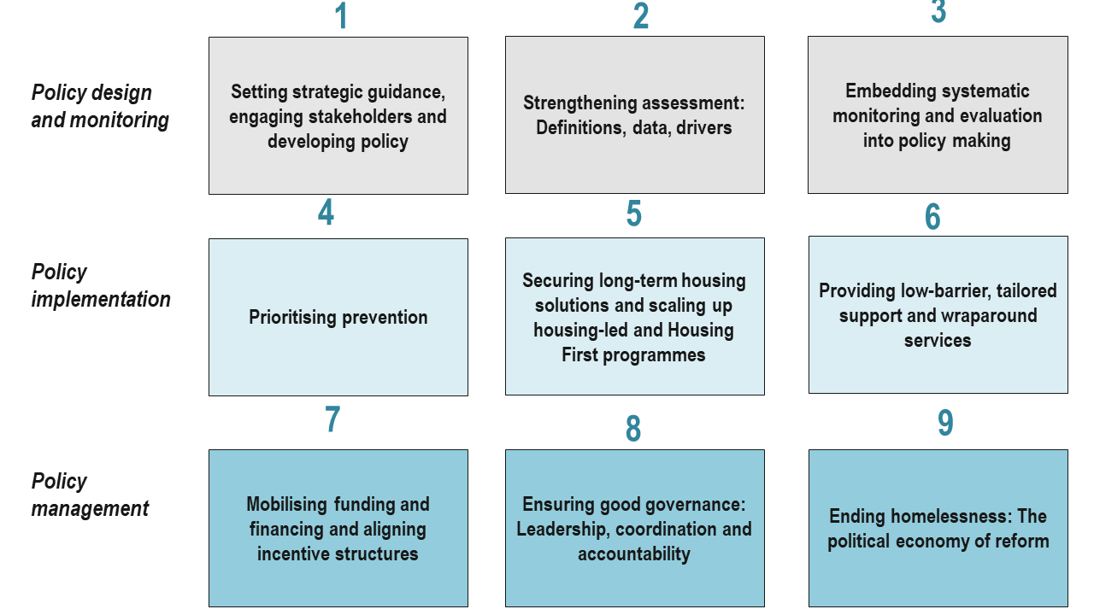
OECD Toolkit to Combat Homelessness | 9 Building Blocks

Slide 10
Toolkit to Combat Homelessness | Structure of each building block
Building Block
Relevance and key data relating to the building block, describing its importance and drawing on the latest research and policy practice
Selection criteria for good practices:
Effectiveness
Coherence
Replicability
Geographic diversity
Innovation
Operational issues for policy makers and practitioners to identify key areas for action, accompanied by 2-3 implementation illustrations from OECD and EU countries
A series of proposed recommendations that constitute the fundamentals for success and, where possible, an indication of where to begin, regardless of countries’ starting point

Slide 11
A practical guide for policy makers and practitioners
Who is this Toolkit for?
What is the purpose of the Toolkit?
How to use the Toolkit?

Slide 12
BUILDING BLOCK 4: PRIORITISING PREVENTION

Slide 13
Block 4: Prioritising prevention | Relevance
Universal prevention
Social protection
Upstream prevention
Critical Time Interventions to prepare discharge from an institutional setting (care facility, hospital, prison…) or youth ageing out of care
Crisis prevention
Eviction prevention (mediation, counselling, financial support…)
Emergency prevention
Housing benefits
Social rental housing
Supporting people at immediate risk of sleeping rough (e.g. through shelters & hostels)
Repeat prevention
Preventing a return to homelessness (Rapid rehousing, Housing First)
A typology of homeless prevention
Two-thirds of OECD and EU countries offer support to households at risk of eviction
Support includes counseling, financial aid, and landlord-tenant mediation, mostly provided by municipalities…
...though the availability and types of support vary significantly within and across most countries.
Could be especially relevant in countries with high eviction and overburden rates
Around 21% of GDP goes to public social spending, on average in OECD
Over 40 countries provide housing allowances
Social rental housing is available in most countries
…though the generosity and coverage of such schemes varies widely across countries
Policies to support youth leaving care are currently the most common approach to upstream prevention
Some examples of upstream prevention exist for individuals leaving prisons
There is considerable potential to expand and improve upstream prevention
Source: Figure adapted from Fitzpatrick, Mackie and Wood (2021), “Advancing a Five-Stage Typology of Homelessness Prevention”, International Journal on Homelessness, DOI: 10.5206/ijoh.2021.1.13341.

Slide 14
Block 4: Prioritising prevention | Fundamentals for success
Leverage existing social policies and housing support
to reduce the risk of homelessness, particularly among low-income and vulnerable households.
Provide targeted, timely support to people due to be discharged from any institution
(e.g., prison, hospital, care system or facility) to secure appropriate and safe housing solution.
Prevent evictions whenever possible,
and, when needed, provide targeted assistance to people facing eviction to help them find an appropriate housing solution.
Ensure access to safe, quality emergency accommodation with low barriers of entry
to prevent individuals from sleeping rough and guaranteeing that facilities are welcoming and safe for all individual without preconditons.
Explore novel approaches to prevention,
including early warning systems using big data technologies.

Slide 15
BUILDING BLOCK 5: SECURING LONG-TERM HOUSING SOLUTIONS

Slide 16
Block 5: Securing long-term housing solutions | Relevance
Broad consensus and strong evidence that Housing First and housing-led solutions are effective (in terms of housing stability) and resource-efficient over the medium to long term (e.g., Baxter et al., 2019, Loubière et al., 2022).
Housing First: typically for individuals with more complex needs
Housing-led: targeted for individuals with low, or no, service needs
Key finding from the 2023 OECD QuASH:
Two-thirds of OECD/EU countries of report that a Housing First or housing-led approach to homelessness exists at national or subnational level in their country.

Slide 17
BUILDING BLOCK 6: Providing low-barrier, tailored wraparound services

Slide 18
Block 6: Providing low-barrier, tailored wraparound services
Carry out a comprehensive needs assessment to identify individual needs and circumstances of people experiencing or at risk of homelessness.
Offer low-barrier services and provide trainings to mainstream service providers
to eliminate administrative, logistical, and social hurdles to access services.
Coordinate health and social services
to provide targeted treatment and care to meet individuals’ needs that extend beyond housing and bring services to the people.
Strengthen access to employment opportunities for people who are able to work
by reducing barriers through training and sustained support.

Slide 19
Strengthening the capacity of the workforce to combat homelessness

Slide 20
Building an effective workforce to combat homelessness | The health and social care sector employs 1 in 10 workers on average – the majority of whom are women.
Employment in health and social work as a share of total employment, by gender
2021 (or nearest year)
Source: OECD (2023), Health at a Glance 2023

Slide 21
Workers in the social, health and homelessness sector face multiple challenges.
“
Poor pay
Precarious contracts
High turnover
Lack of training
Poor mental health, burn out
Limited recognition
Frustration (e.g. challenges to overcome the systemic barriers to support people experiencing homelessness)
‘“Constantly battling a biased social system with inadequate resources, […] can […] lead to feeling overwhelmed and defeated…”
Peters, Hobson & Samuel (2022) – Paper 9
”
“I love my job […]. Nevertheless, I have never felt so much despair and helplessness before in all my life.”
Peters, Hobson & Samuel (2022) – Paper 10

Slide 22
Proposed guidance and implementation illustrations |
Strengthening the capacity of the workforce to combat homelessness
Drawing inspiration from recent developments in the long-term care sector…
Increase wages and working conditions of workers in the health, social services and homelessness sectors
Boost training opportunities, including obligatory training
Provide (more) counselling services to frontline staff

Slide 23
(Alexandre.Lloyd@oecd.org)
OECD work on homelessness
From your perspective, are the policy areas – the “building blocks” – the “right” ones? Are we missing anything?
Are recommendations the “right” ones? Should any of them be reformulated?
What could be done to make this Toolkit as useful as possible?
Forthcoming:
Data brief: Challenges to measuring homelessness among migrants in OECD and EU countries
Full draft: OECD Toolkit to Combat Homelessness

Slide 24
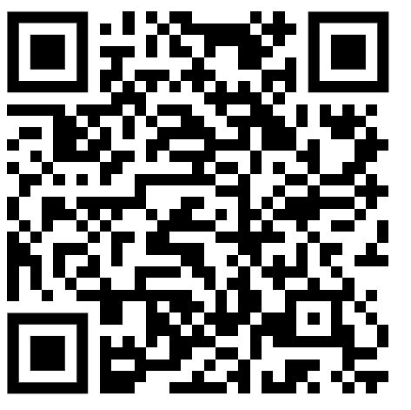
Thank you and Sign up for updates on our work:
CONTACTS
Willem Adema (Willem.Adema@oecd.org)
Marissa Plouin (Marissa.Plouin@oecd.org)
Ali Bargu (Ali.Bargu@oecd.org)
Alexandre Lloyd (Alexandre.Lloyd@oecd.org)

