Slide 1
Housing, homelessness, and fuel poverty
Carolyn Snell*, Nicholas Pleace, Anna Browning, Sara Anderson
*carolyn.snell@york.ac.uk

Slide 2
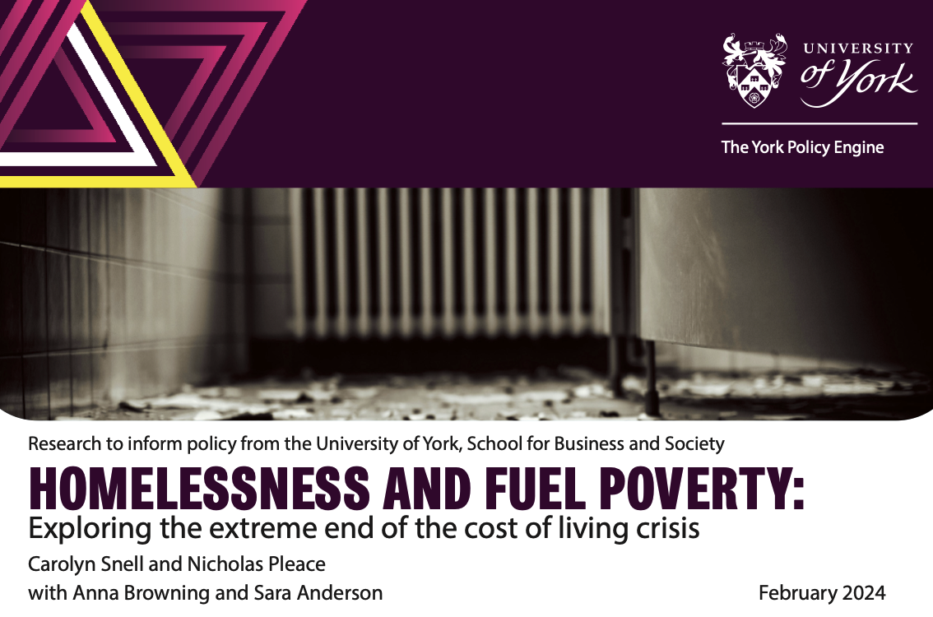
Why we decided to do this
We used to think homelessness in Victorian ways, as resulting from ‘sin’ (addiction) and ‘sickness’ (mental illness)
We now see homelessness more in terms of ‘systems’ - as linked to inequality, poverty, cuts to social housing and social protection
Fuel poverty potentially important as a cause of homelessness and a barrier to exiting homelessness and the sudden spike in costs created a space for this research

Slide 3
Existing knowledge on the topic
We have known for some time that levels of poverty inequality and the nature of welfare systems were linked to the level and nature of UK and European homelessness, but it has been hard to see the specific effects of economic, social, political and policy and individual experiences, characteristics and choices
The sudden spike in energy costs gave us a way to explore how a specific dimension of poverty - that we had long suspected had a role in homelessness - might be influencing causation, experiences and capacities to exit homelessness
The UK homeless sector quickly delivered research showing negative effects from the energy crisis, but this research took a longer and more detailed look at what the issues were and what was happening over time

Slide 4
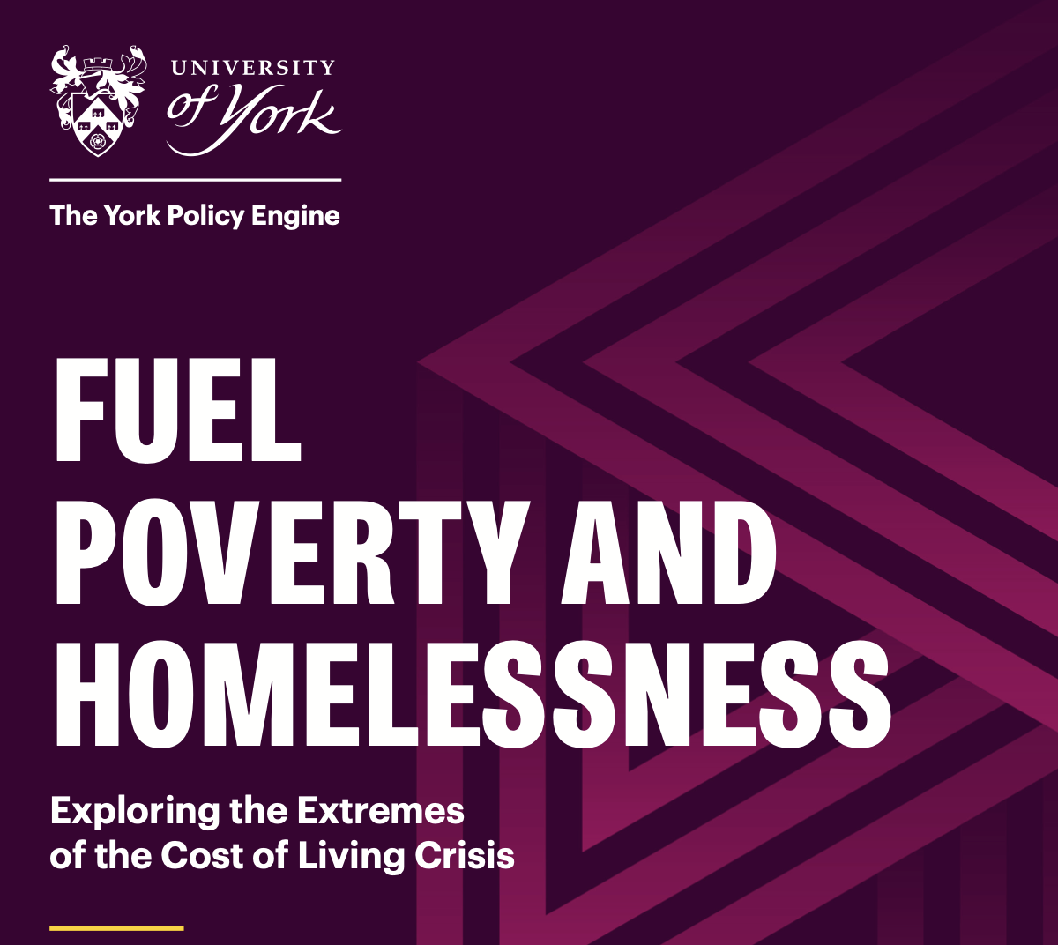
Research questions
The impact of the energy crisis on:
How has the energy crisis affected people at risk or who are homeless?
How has the energy crisis affected the ability of services to support people?
How effective have policy measures been/what needs to be improved?

Slide 5
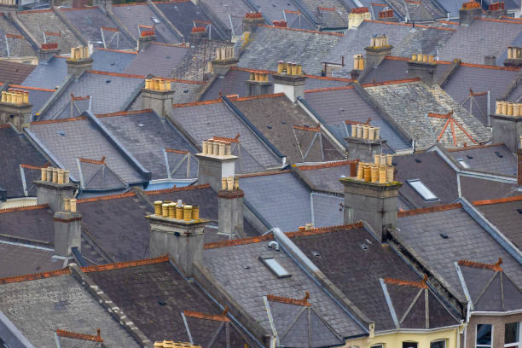
Qualitative method
Case study city
9 Frontline service providers
9 ‘lived experience’ interviews
Expert interviews
3 international experts
8 policy experts

Slide 6
Before we go any further...Robin’s story
’I’m on pre-pay for the electric and it’s a standard bill for the gas. It’s just going up and up. I’m finding it hard to heat the place and literally the electric is disappearing, it’s the standing charges they are ridiculous. It’s getting worse. I’ve got my heating on an hour a day, worried I use too much gas and I’m in debt with that a little too and I’m trying to pay that back too. It’s a case of duvets, jumpers and coats in the house which is not ideal. It’s affected my eating habits too; I’m having one hot meal a day and cooking once a day. I’m getting sandwiches but one hot meal. I’m minimising the time I’m using it, not using the oven.... ‘
‘Robin’, Recipient of a supported living scheme, Northern City, Interviewed in November 2023
‘Honestly, I just want to be able to get carpets for my property. I was putting money aside for it while I was working, but can’t now. I’ve had to use that to survive. I can’t afford carpets and that makes it harder to heat and stay warm as well. I’m losing the heat I’m putting in as there’s no insulation. I have to sit by the radiator you know..
I want to become a secure tenant in this place. Obviously at the moment I’m only an introductory tenant so I’m worrying that after losing my job I might lose this home too. These arrears are really worrying me. I’m hoping if I keep showing them that I want to pay and keep paying as much as I can it will help’

Slide 7
Headline findings
The impact of the cost-of-living crisis on homelessness and housing precarity
The impact of the cost-of-living crisis on organisations and service delivery
The impact of policy responses
Notes:
Point 1 - spend the longest on

Slide 8
Impacts: New People and New Extremes 1
‘The last straw’
Evidence of extreme fuel poverty and destitution
New households experiencing fuel poverty for the first time
‘I think the other thing for me, we’ve got people begging on the streets... And we’ve seen a rise in people begging, ‘to put lecky on,’ their words.’ [City homeless team member]
Notes:
Fear of eviction as a result of housing and energy debts

Slide 9
Impacts: New people and new extremes 2
Spatial shrink within the home
Increased debt
Increased self-disconnection
New extremes - burning personal items, switching off fridges, not washing, using hobs as heating
People will sort of live in their living rooms, so we’ll have a duvet, we’ll have a plug-in electric heater, and they will just stay in that living room for a winter period and leave the rest of the house unheated, because they can’t afford to do it. It’s just horrible. [Expert]
Notes:
Fear of eviction as a result of housing and energy debts

Slide 10
The impact of the cost of living crisis on homelessness and housing precarity Renting and Landlords
‘Race to the bottom’ in the rental sector
Poor energy efficiency
Routes into housing often place households in fuel poverty
Elevated fear and risk of eviction
It were...the price of renting houses and that went up... So, I just couldn’t afford to get a flat. So that’s why I ended up in here [person experiencing homelessness]
Notes:
Fear of eviction as a result of housing and energy debts

Slide 11
Impacts: Hidden Homelessness
Increased rents, energy costs, and other price increases linked to hidden homelessness and housing precarity
Increase in sofa surfing, sharing, overcrowding, and other informal housing
For every person that gets evicted by formal processes, there’ll be a handful of other people who will just leave the home that they’ve got massive rent arrears on, and will just go and sofa surf somewhere else, or sleep in their car or do something else, and just disappear from services because they won’t take it to the line…So there will be more people, I would guess, that kind of disappear beyond the data that we’re capturing [National energy charity]

Slide 12
Impacts: Direct increases in homelessness
The biggest impact I’ve seen is people who were previously rough sleeping going into [Housing First] properties, going back onto the streets because they just, what we budgeted for them moving in with, the energy has gone through the roof. They’ve got no electricity; they’ve got no gas. They’re going back to what they know. So, years of work to break that conditioning, if you like, back to square one with quite a few of ours… We’ve got .. clients saying, ‘I don’t want a flat, I want a bedsit because I can’t afford it.’ They’re actually saying that. [Homelessness service provider]

Slide 13
Impacts: Delaying exits from homelessness
So, we have also heard of people saying they have people who are fully ready to move on and would be fine to live independently, they can’t afford it. So, they can’t, they’re not going to move them out and set them up to fail… I mean obviously there’s always housing costs, but that’s utilities too, that’s you know, the cost of living independently with all your bills now is too much. They can’t afford it. They’re terrified, so they’re, they’re not able to move them on. And obviously we’re just clogging up already, a very clogged up path system. [Homelessness service provider]
Notes:
B

Slide 14
Impacts on organisations
Less money and more demand
Less ability to provide homelessness services
Less ability to provide fuel poverty services
Loss of capital projects
Loss of staff
…Somebody was around the winter warmth packs, and they were really, really scared about promoting that they had any, because they knew they were going to run out. And they were like [said], ‘We’re so far from winter. We’re so far from winter and, but like, this is, it’s not our job to make decisions over who is more vulnerable than who...’’

Slide 15
The impact of policy responses
Targeting and take up of support
The impact of business tariffs
Structural issues remain unaddressed
What’s going to happen when, the demographic of people in fuel poverty is increasing, but now the support is not available for many of those people unless they get certain benefits… there’s like, I say, there’s a lot of other people who are struggling. They’re not going to receive the support. And again, it’s just a sticking plaster [Homelessness service provider]

Slide 16
UK Energy Policy Recommendations
Ensure access to financial assistance and lowest energy prices for people at risk of homelessness or trying to exit homelessness
Stop homelessness services having to pay the same energy costs as businesses and provide support with costs
Support retrofit of homelessness services
Support retrofit of homes for lower income people including housing used to end homelessness
Notes:
B

Slide 17
UK Homelessness Policy Recommendations
Enable funding levels for homelessness services to adjust to increases in energy costs and the wider cost of living crisis rather than keeping their budgets fixed for one or more years
Ensure that staff working in the homelessness sector are paid a living wage [not just the UK legal minimum wage] so that their wellbeing and security is not threatened by fuel poverty and the wider cost-of-living crisis
Notes:
B

Slide 18
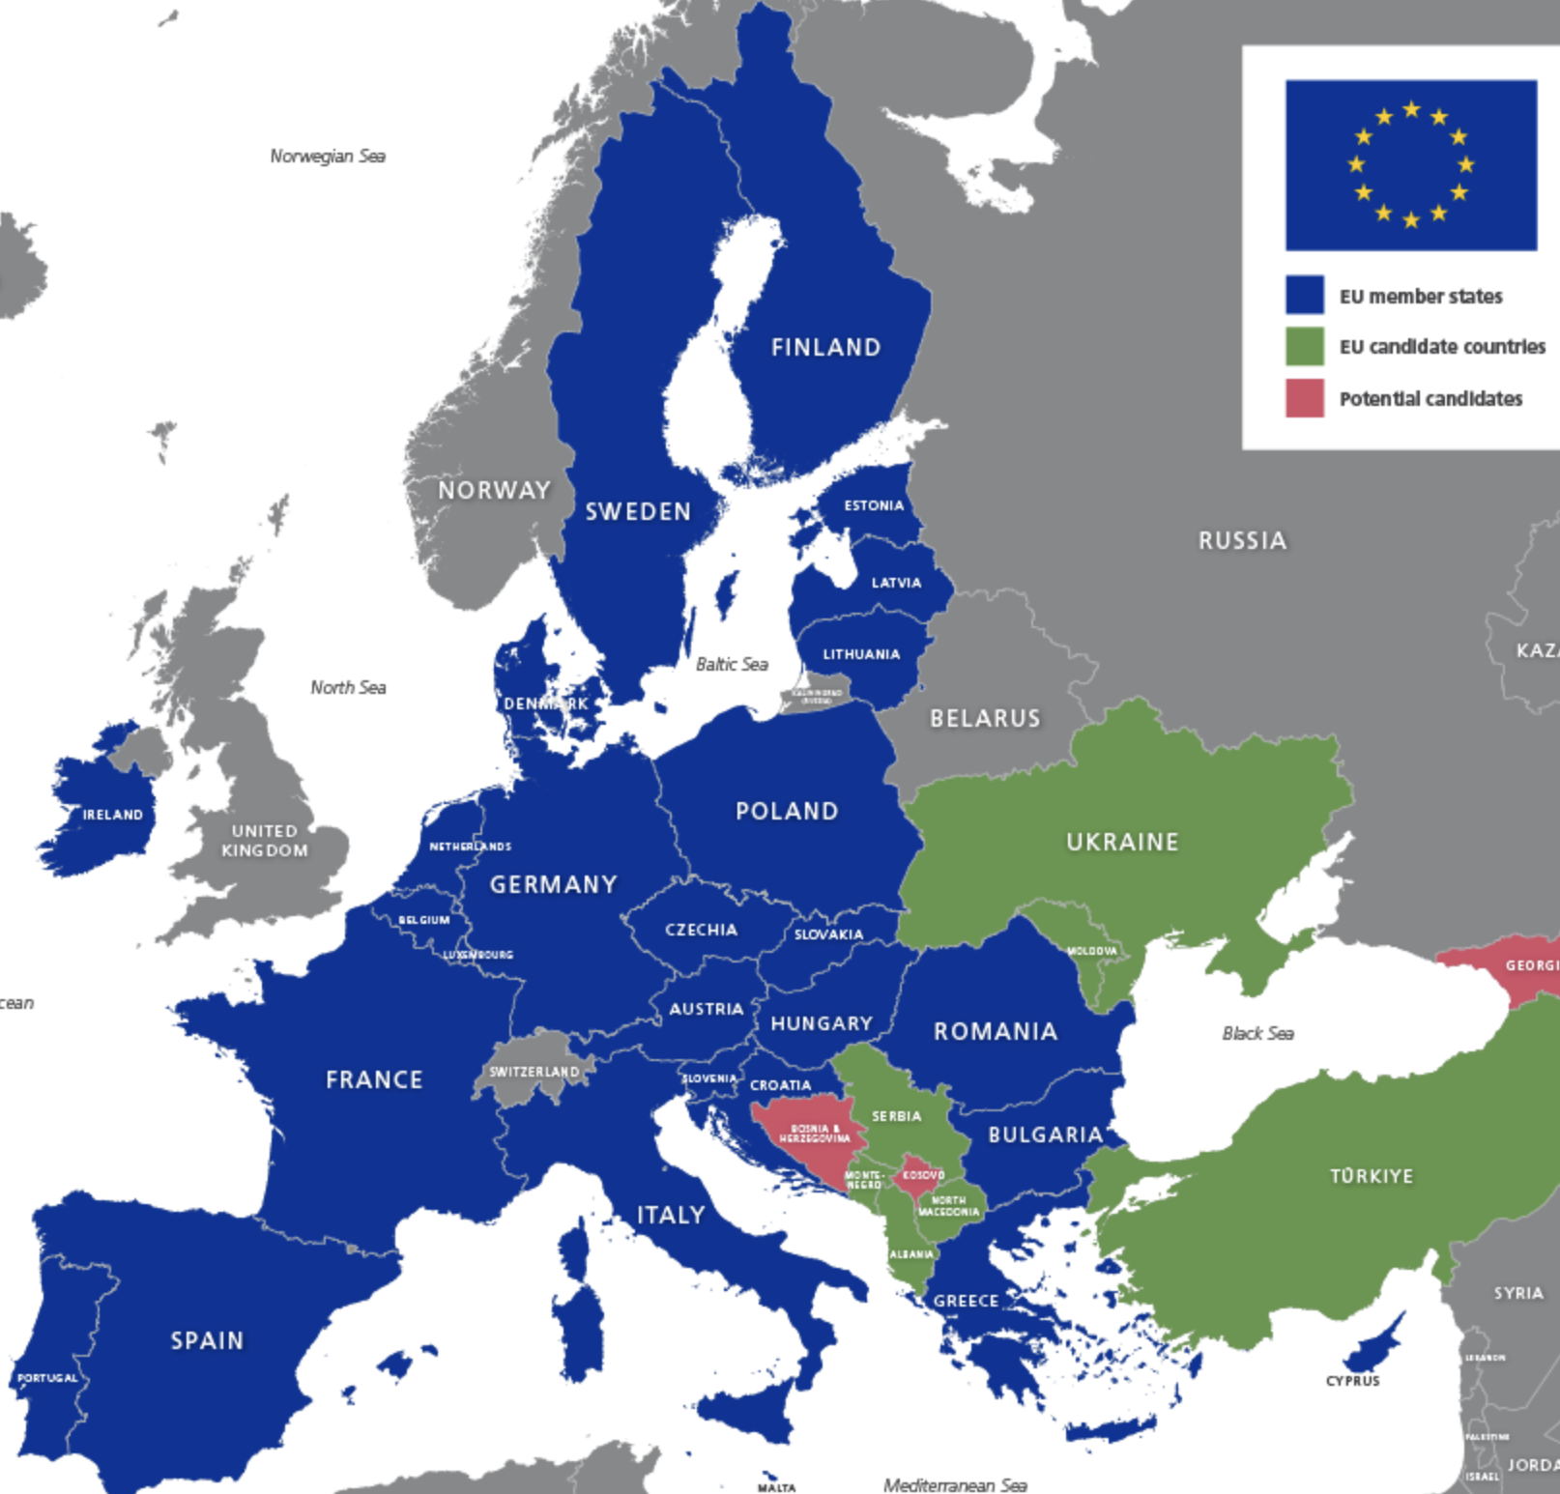
European Implications
Fuel Poverty may be a driver of homelessness on its own
But it may be a more important cause of homelessness
And difficulties in exiting homelessness
In a context of rising housing costs, commodified housing markets, increased inequality and food insecurity ‘heat or eat or pay the rent’.
Notes:
B

Slide 19
European Implications
The climate resilience of homelessness systems and strategies has not really been considered
Fuel poverty, while caused by the Ukrainian war with variable and (currently) fading effects stems from patterns of energy use, insulation, heating and cooling systems that are often inherently inefficient
The implications for the costs of building and running homelessness services, preventing and providing exits from homelessness may be much more immediate that we were expecting
Notes:
B

Slide 20
Renoviction
FEANTSA has been highlighting the risks of ‘renoviction’ for several years
Costs of compulsory regulation of thermal efficiency are passed on from landlords and developers to tenants
Costs of housing increase because it is being retrofitted or built to passivhaus and similar standards
Increased risks of housing inequality and homelessness
Fuel poverty is obviously very closely linked to thermal efficiency and CO2 reduction
Notes:
B

Slide 21
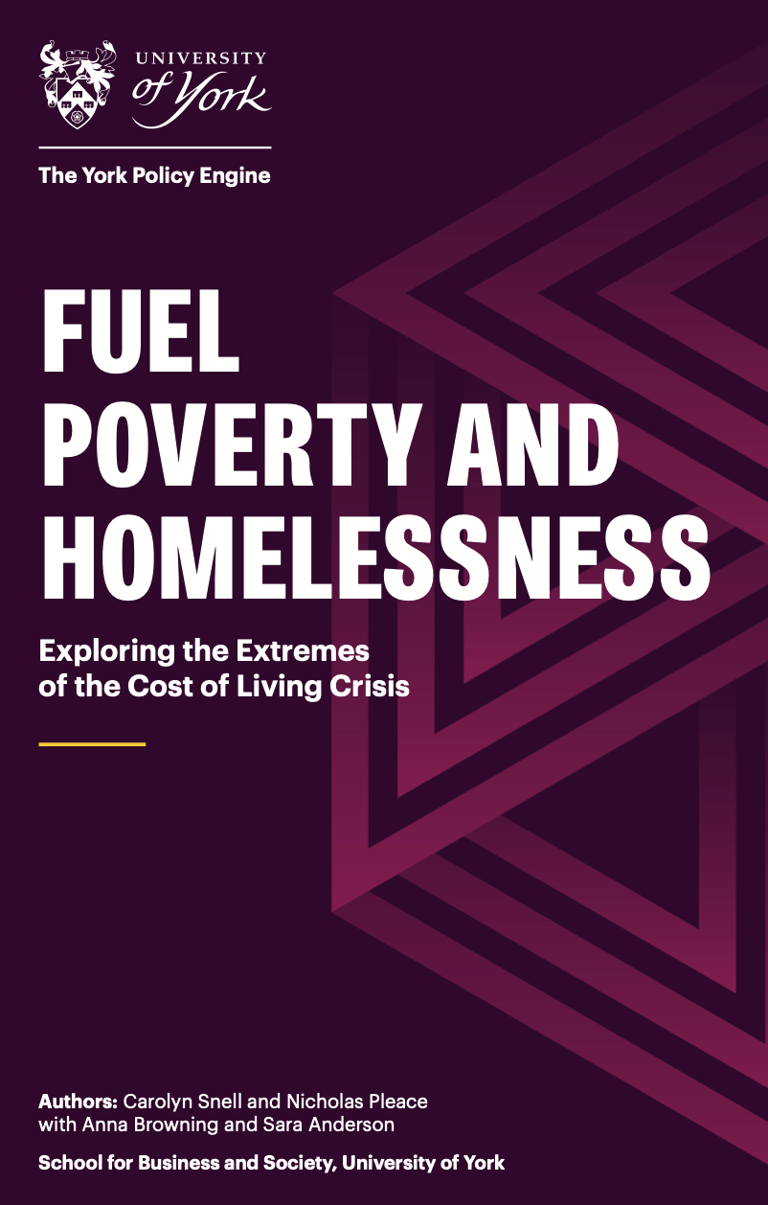
Conclusions
Fuel poverty intersects with profound social problems with inequality and destitution in the UK, it is a trigger for homelessness and can hamper exits from homelessness
Fuel poverty also impacts significantly on the capacity of homelessness systems to prevent and reduce homelessness
Especially when the impacts of the energy crisis are not acknowledged, and no strategic response is developed

Slide 22
Next steps - PRS
Role of landlords as blockers to improved energy efficiency and reduced bills
Extreme examples of fuel poverty
Moving children out of worst spaces
Damp, mould, property decay
Cost of living crisis constraining options
Can’t move out
Living in broken down relationships
For example, there was like an energy scheme last year and because I was on universal credit they would have put in paid for like wall insulation and like the smart radiators and my landlord wouldn't do it…

Slide 23
Thanks for listening! Nicholas.pleace@york.ac.uk Carolyn.snell@york.ac.uk

