Slide 1
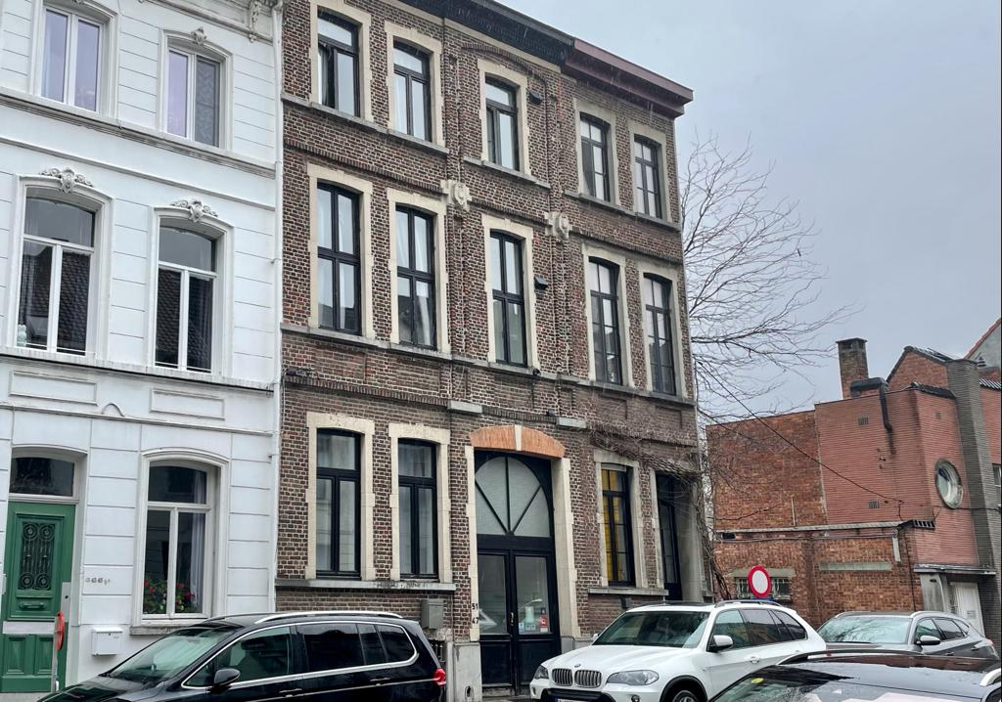


Shelter with guidance for people without legal residence
(Opvang & Oriëntatie (O&O) mensen zonder wettig verblijf)
Ghent - Belgium

Slide 2
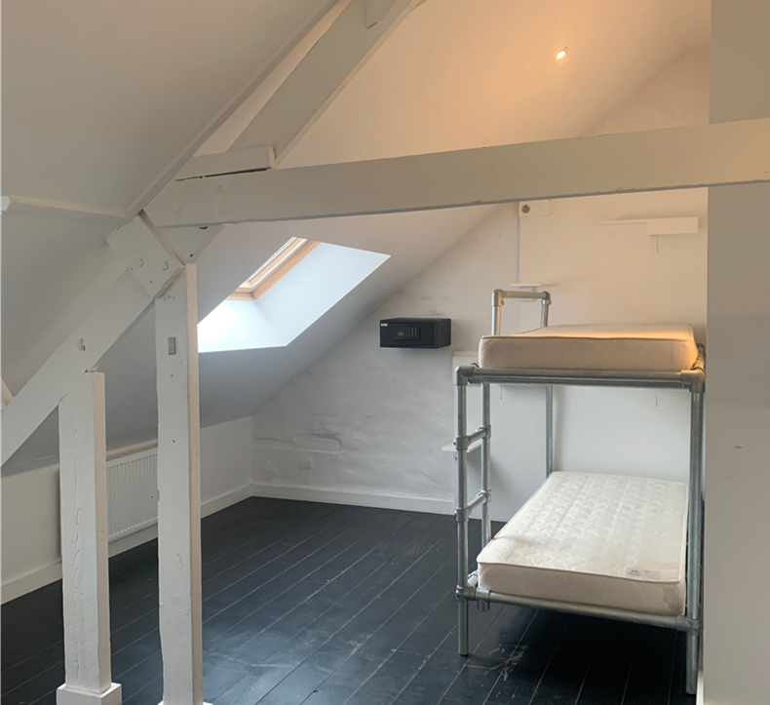
WHAT
Three aspects:
Shelter
Perspective guidance
Legal guidance
    No time limit!
Intensive guidance focused on a sustainable, realistic and legal perspective linked to peace and space in a 24-hour shelter.
↘
shift from the survival strategy of the street to a safe situation

Slide 3
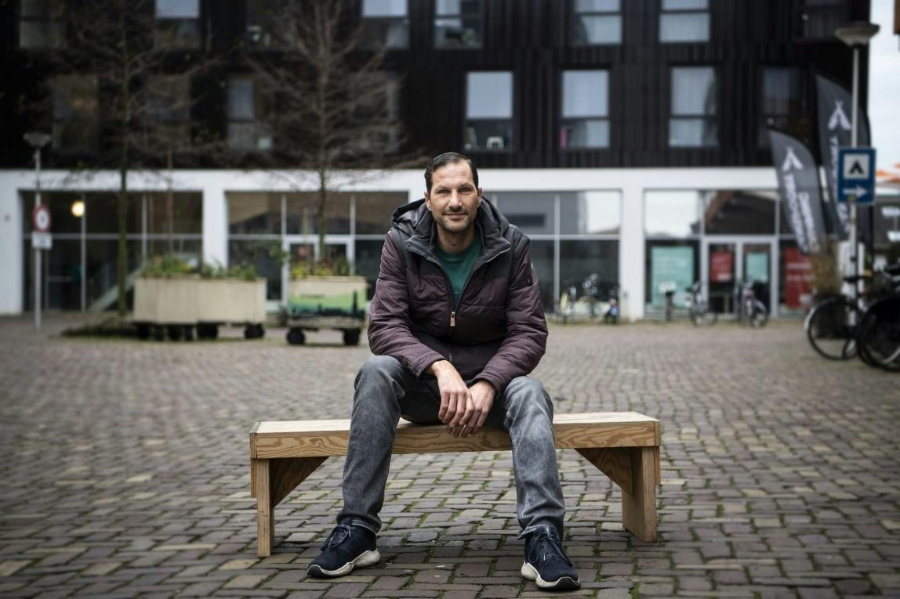
WHO
    18 homeless people without legal residence (non European Union)
being needy (not having an income to provide shelter)
having a connection with Ghent.
being homeless
being a foreigner without legal residence.
vulnerability
sufficient indications for a path towards a
sustainable future perspective.

Slide 4
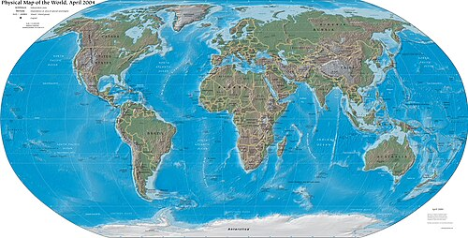
Nationalities
Algeria
        Afghanistan
Tunisia
Morocco
Iran
Ghana
Togo
Nigeria
Russia
Notes:
Duidelijke focus op Afghanistan en Magreb

Slide 5

HOMELESS = HOMELESS?
Not a standard shelter for the homeless:
Specific statute (very few rights (less money); less posibilities for daytime activities/voluntary work, End of legal proceedings = end of possibilities) Specific guidance (perspective and legal guidance instead of housing assistance)
Specific needs: Almost 100% of the residents has serious mental problems (PTSS, refugee/migration trauma, street trauma, label 'illegal’’ trauma and due to compensation with alcohol, medication, …)
Living together with people with the same background and story 'without papers' has advantages and disadvantages (Recognizable situation = support – Comparing situations = demotivating)

Slide 6

INFLOW PROCEDURE
    Various organisations in Ghent can direct candidates to the project
    Registration form (together with resident)
    Screening interview (social workers)
    Advice note
    Decision committee (shelter – worklist – other option)
Notes:
OCMW, Outreach, CAW, vrijwilligersorganisaties

Slide 7

Everything starts with …
Rest, Space and Respect!
Living on the street is never an option for a sustainable future
O&O is no end-of-the-line but a starting point
We start out of believe in the story of the resident
We ask for commitment to explore all possibilities
A motivated choice can only be made when there is faith that all possibilities are investigated

Slide 8
Guidance
Shelter worker
Day-to-day support
Living together
Legal guidance
Legal possibilities and limitations
Explain – "Translate" – Advise
Contacts with authorities
(Support with) submitting applications
Perspective guidance
Individual proces
In all areas of life
Linked to legal process
Focused on a sustainable future (Belgium – country of origin – other country)

Slide 9

Collaboration with Migration Services
Federal Agency for the Reception of Asylum Seekers (Fedasil) responsible for the reception of asylum seekers and voluntary return
Contract Fedasil and the City of Ghent for financing O&O as a pilot project. Subsidy of 140,000 euros/2 years. The City of Ghent delegates this to CAW
Points of discussion CAW - Fedasil:
- Residents with criminal offences/radicalism profile in O&O?→ agreement: extract from criminal records at registration and then check the individually case (offences by survival strategy)
- Passing on information about the residents? → agreement: only with the residents permission.
  Cooperation Return Desk Fedasil: expectation when return is a valid perpective, return desk will be called in
  Discussion point CAW - Return Desk:
  CAW does not enter the Return Desk enough ↔ Great resistance from the residents. → agreement: we engage the return desk much earlier in the guidance process as a partner with great expertise in country information (e.g. whether or not a medicine is available in a certain country) in order to lower the resistance on the part of residents.
Notes:
Vrijwillige en gedwongen terugkeer:
Fedasil: federaal agentschap voor de opvang van asielzoekers (staatssecretaris voor asiel en migratie) oa verantwoordelijk voor het programma vrijwillige terugkeer in België. Terugkeerloketten om mensen te informeren (enkel grote steden)
IOM: Internationale organisatie voor migratie: is verantwoordelijk voor de praktische organisatie vd terugkeerreis
FOD Binnenlandse zaken, DVZ icam coaches): toegang, verblijf, vestging, verwijdering vreemdelingen grondgebied. O.a. verantwoordelijk voor gedwongen terugkeer. Bevel om grondgebied te verlaten, gesloten centra
IOM en Caritas: zorgen voor re-integratie in het terugkeerland
Commissariaat-generaal voor de Vluchtelingen en de Staatlozen (CGVS): beslissing over het verzoek tot internationale bescherming. Eerst aanmelden en eerste gesprek bij DVZ dan over naar tweede gesprek voor diepgaand interview met CGVS

Slide 10

Collaboration with Migration Services
Immigration Office (DVZ) Responsible for entry, residence, establishment and removal of refugees (incl for forced returns)
ICAM coaches: individual counselling for undocumented migrants: legal residence – return (only give advice, no applications). https://dofi.ibz.be/en/ICAM
↘
Agreements:
- Case priority for residents in O&O at the Immigration Office to prevent the project from clogging up (via the Icam coach)
- Icam coaches: case consultation on the expected response from the Immigration Office when considering the application for regularization, sometimes communication of negative decisions of the Immigration Office to residents, ...
- City of Ghent and Ghent police zone: do not arrest people who are staying in O&O!
Notes:
Vrijwillige en gedwongen terugkeer:
Fedasil: federaal agentschap voor de opvang van asielzoekers (staatssecretaris voor asiel en migratie) oa verantwoordelijk voor het programma vrijwillige terugkeer in België. Terugkeerloketten om mensen te informeren (enkel grote steden)
IOM: Internationale organisatie voor migratie: is verantwoordelijk voor de praktische organisatie vd terugkeerreis
FOD Binnenlandse zaken, DVZ icam coaches): toegang, verblijf, vestging, verwijdering vreemdelingen grondgebied. O.a. verantwoordelijk voor gedwongen terugkeer. Bevel om grondgebied te verlaten, gesloten centra
Commissariaat-generaal voor de Vluchtelingen en de Staatlozen

Slide 11
Collaboration with other organisations
  City Gent politics: pressure to focus more on voluntary return
  Caritas International and IOM: responsible for the practical organisation of the return trip. Collaboration idem Return Desk: early in the process to provide country expertise
  UNHCR: the UN refugee agency, works worldwide to accommodate people on the move.
  Nansen vzw: legal aid and support for refugees
  Orbit vzw: project development O&O and advocacy of undocumented migrants
  Street outreach work: consultation on the homeless
  OCMW Ghent: medical card, screening potential residents
  Legal clinic (University of Ghent): lawyers in training with a specialization in immigration law look at the cases in O&O.
  And the usual services for people who are homeless: Uitpas, social restaurants, foodsavers, red lotus, ...
Notes:
IOM: internationale organisatie voor migratie. Praktische regeling terugkeerreis
IOM en Caritas: zorgen voor re-integratie in het terugkeerland

Slide 12
Some results
Shelter with guidance O&O | 2022 – 2023 (24 months)
Residents with legal guidance | 37*
Positively completed procedures | 11
International protection | 4
Humanitairian regularization | 4
Medical regularization | 2
Others (re-registration) | 1
Voluntary return | 0
Forced return | 0
Average duration of stay in Belgium before O&O: 11 years!
Average number of procedures before O&O:
3
Maximum number of procedures before O&O: 8
* 20 in shelter, 17 on worklist (who get legal guidance)

Slide 13

FUNDS
City of Ghent 460.000 euro/2 years
(Ghent gets a Federal fund from Asylum and migration for about 140.000,-/2 years, as a pilot project)
Staff costs
      1,6 fte shelter employee
      1,5 fte perspective guidance
      1,6 fte legal guidance
      0,3 fte manager
Operating costs
      Building (repair, insurance, cleaning, …)
      Translation and interpreter cost
      Food
      …

Slide 14
CAUTIONAL CONCLUSIONS AFTER 2 YEARS O&O …
Psychological vulnerability of our residents has many consequences: poor access to procedures, specialized psychological help, a lot of time and rest needed in the guidance proces, abuse of alcohol/drugs/medication,...
Survival crime leads too quickly to the conclusion that someone is a danger to public order
Participants have little insight into their procedural past
Need for accessible, up-to-date and specific country information
Residents have valuable skills that can be used for bottleneck professions.
Need for multidisciplinary and persistent guidance
The need for guidance does not stop when the participant gets regularization

Slide 15

REFLECTIONS?
QUESTIONS?

Slide 16
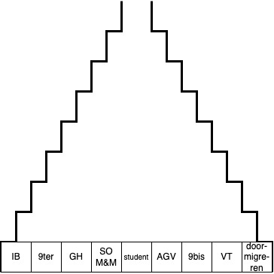

Legal guidance: Methodology
Funnel Model:
Start with all legal options.
- Trying to visually illustrate what the options are.
- Including options outside stay in Belgium
- Gradually finding out with the client which ones are not legally possible
eliminate
- Which one will be left in the end?
- Participant maximum insight and decision
- Tandem with perspective supervisor-

Slide 17
Perspective guidance: Working together on a sustainable future perspective
End goal: the resident makes a well-founded choice regarding his future and is also able to realize it
  ➔Legal residence in Belgium
  ➔ Safe resettlement in country of origin or third country
Housing
Inspiration and meaning
Daytime activities, work, training
Health
Network and relationships

Slide 18
Perspective guidance: Working on well-being and self-reliance
FIND - Connecting/Building a Mutual Bond
Putting small things in order together
Carry out daily activities together (e.g. shopping, cooking,...)
Climate of trust and security
MIND – Developing a client development plan together (e.g. based on a strength inventory)
  Mapping forces in the past and present
  Positive experiences,
  Competences
  Sources of support in the networkWensen en dromen voor de toekomst
  Barriers
  Formulating goals
BIND - Supporting and guiding the client through appropriate interventions in achieving goals

