Slide 1
Using AI to Improve Homelessness Services
Dr. Geoffrey Messier Department of Electrical & Software Engineering
Schulich School of Engineering
University of Calgary

Slide 2
Supporters and Partners
This study is based in part on data provided by Alberta Seniors, Community and Social Services. The interpretations and conclusions contained herein are those of the researchers and do not necessarily represent the views of the Government of Alberta. Neither the Government of Alberta nor Alberta Seniors, Community and Social Services express any opinion in relation to this study.

Slide 3
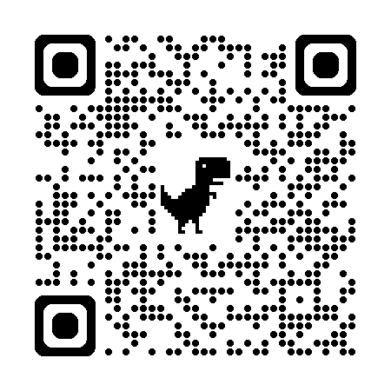
The Canadian Truth and Reconciliation Committee (TRC)
The TRC was launched in 2008 as part of the Indian Residential Schools Settlement agreement.
The TRC delivered a final report in 2015 that included 94 Calls to Action for Canadians and the Canadian government.
National Centre for Truth and Reconciliation
It is now accepted practice for Canadians to acknowledge the indigenous people who lived on the land before settlers arrived.

Slide 4
Land Acknowledgement
The University of Calgary, located in the heart of Southern Alberta, both acknowledges and pays tribute to the traditional territories of the peoples of Treaty 7, which include the Blackfoot Confederacy (comprised of the Siksika, the Piikani, and the Kainai First Nations), the Tsuut’ina First Nation, and the Stoney Nakoda (including Chiniki, Bearspaw, and Goodstoney First Nations). The City of Calgary is also home to the Métis Nation of Alberta (Districts 5 and 6).

Slide 5
Objectives
Define exactly what we mean by “artificial intelligence”.
Provide some simple rules for when it is/isn’t useful.
Discuss some example cases where it has value when providing housing/homelessness services.
Highlight some things to keep in mind when using AI in an ethical way.

Slide 6
What is artificial intelligence?
Any computer program that can “learn” from past data.
An AI tool is trained by exposing it to patterns in past data.
An AI tool can predict if something will happen by spotting patterns in future data that it observed during training.
An AI tool can also generate new data based on the patterns it observed during training (“generative AI”).
Example:
An AI tool is trained on images labelled as “dog” or “not dog”.
The AI tool can decide if a new image is or is not a dog.
It could also create new images that look like dogs.

Slide 7
(Geoff’s) Golden Rules of AI and Homelessness
Humans are great, do not replace them with AI.
Well functioning data IT systems must come before AI.
Just like people, AI needs to specialize to work in homelessness.
AI can’t do everything well, only use it for problems it’s good at.

Slide 8
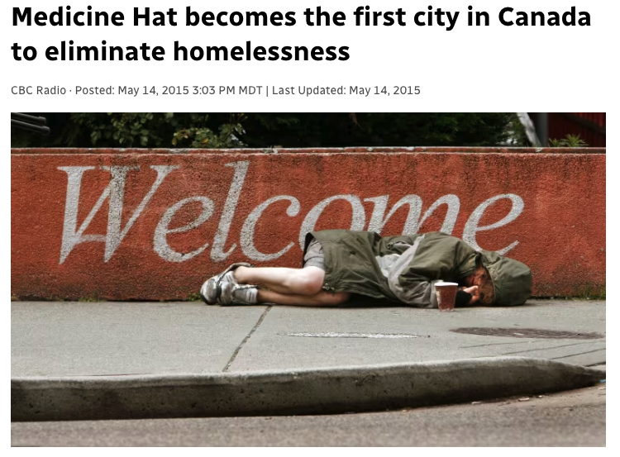
Rule 1: Humans are Great
Making a human connection with people experiencing homelessness is essential.
Sometimes, humans are all you need…

Slide 9
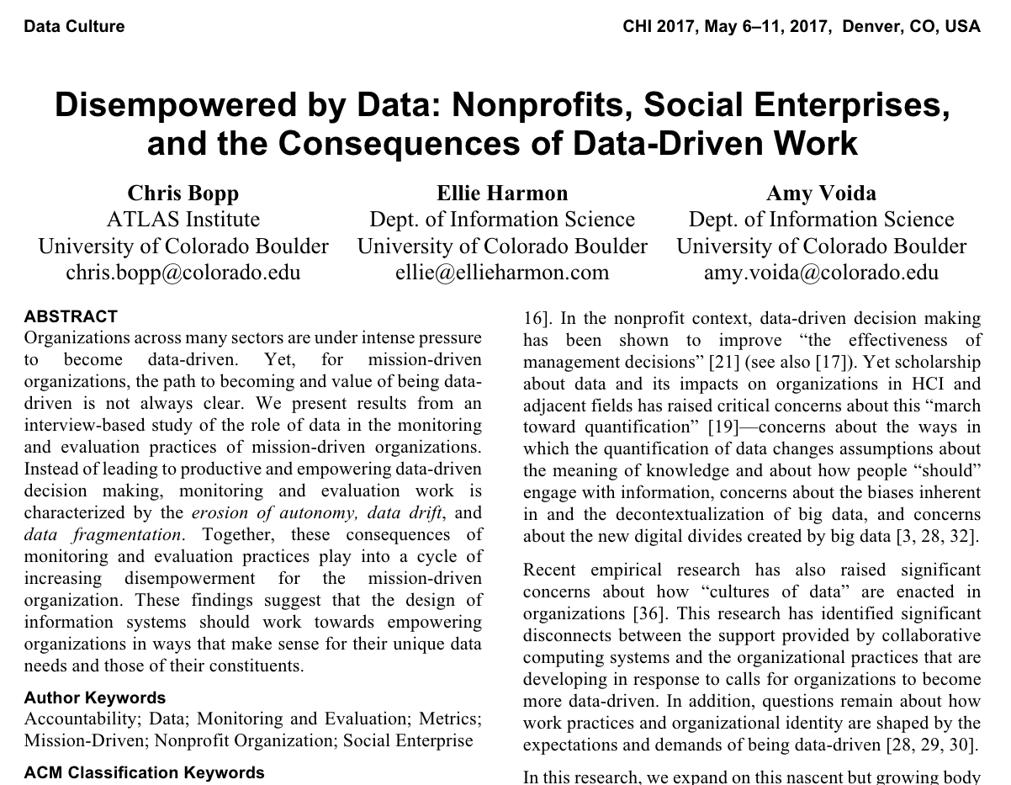
Rule 1: Humans are Great
Working in the homelessness sector is hard.
Data (and AI) should be making this easier but it’s too often the opposite.
The question isn’t “Should I used AI?”
The question is: “Can my staff easily access the information they need to effectively do their jobs?”
Screenshot of Chris Bopp paper

Slide 10
Rule 2: Good Data IT Systems Come First
Ensure you have quality data.
Are your staff recording all the information they need for their jobs?
Are they recording data that is not being used?
Centralized data is key.
Is all your data stored on one database or spread across many spreadsheets?
Your data systems must be user friendly.
How easy is it to enter/update data?
Can staff easily access the information they need to make decisions?
Do your data systems save time or consume time?

Slide 11
Rule 3: Specialists Only
Probably many of your staff are already using AI (aka. ChatGPT).
Question: “Can’t I just cut and paste a person’s housing/homelessness record into ChatGPT and ask it to recommend a support program?”
NO!!!!
ChatGPT is trained on the Internet.
It has spent as much time on homelessness as the entire Internet spends on homelessness.
AI needs to be trained on data that accurately represents the people you are helping.
ChatGPT also runs on servers at a for-profit company in the United States.

Slide 12
Rule 4: Find the Right Problem
When finding problems that are a good fit for AI, consider things like:
Do you see a high volume of people?
Do you experience high staff turnover?
Is it difficult to summarize a person’s data?
Do you spend a lot of time merging or cleaning data?
Case Study 1:
Risk of Chronic
Shelter Use
Case Study 2: Linking Shelter Data

Slide 13
Case Study 1: Risk of Chronic Shelter Use
Case workers and physicians make decisions using:
Client/patient history.
Their assessment of the client/patient’s current condition.
Physicians also use medical measurements (ie. blood pressure, lab tests, etc.).
Could we use machine learning to make a “housing intervention blood pressure test”?
estimate whether a client is at risk of an adverse outcome?

Slide 14
Case Study 1: Risk of Chronic Shelter Use
From 2007 to 2020, the Calgary Drop-In Centre saw an average of 268 new clients per month:
85% are transitional, very short term shelter users
12% are episodic users with large gaps in shelter use
3% are long term, chronic shelter users
Most Housing First strategies prioritize chronic clients.
How do we know who is chronic?
Wait a long time.
Use machine learning to find patterns in early shelter use that suggest someone is at risk of becoming chronic.

Slide 15
Case Study 1: Risk of Chronic Shelter Use
Rule set techniques process historical client data to find the best threshold-style tests for identifying an at-risk group.
Using historical Calgary Drop-In Centre data, chronic clients can be identified by the following rule:
Precision: 71%
71% of clients identified by the test actually became chronic.
Recall: 77%
77% of all chronic clients are identified by this test.
In a Client’s First 60 Days:
(Shelter Sleeps)$≥54$ AND (Counsellor Meetings)$≤11$

Slide 16
Case Study 2: Record Linkage
Trellis Society youth data:
20,822 client profiles across 75 different programs.
Calgary Homeless Foundation adult data.
264,065 client profiles across 150 different programs.
Many profiles refer to the same person.
Linking them helps us understand how young people transition to the adult system of care.
Profiles can be linked by comparing names and birthdates... but we must perform 40,580,158,941 comparisons!
Machine learning can do for us in approximately 6 hours.

Slide 17
Case Study 2: Record Linkage
A human can spot the similarity between “Geoff” and “Jeoff” but humans can’t scan thousands of records.
Computers calculate metrics that measure word similarity:
An edit distance metric counts the number of character edits to change one word to another.
These edits include insertions, deletions and substitutions.
Examples
“Geoff” ↔ “Jeoff”: Dist = 1 (1 substitution)
“Geoff” ↔ “Jeffrey”: Dist = 5 (1 substitution, 1 deletion, 3 insertions)
Machine learning can spot when names are close enough to declare a match.
Bloom filters allow us to scramble names to preserve privacy and still calculate a similarity metric.

Slide 18
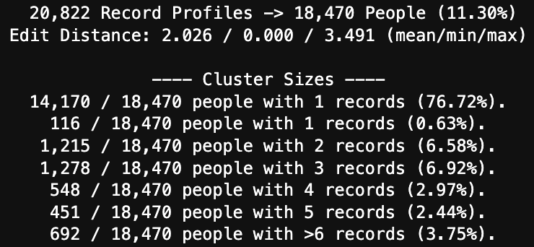
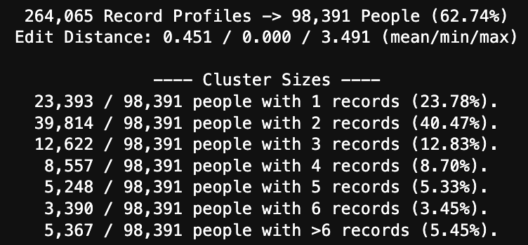
Case Study 2: Record Linkage
Each of the 284,887 profiles were compared with every other profile (40,580,158,941 comparisons).
Trellis Data Set
CHF Data Set

Slide 19
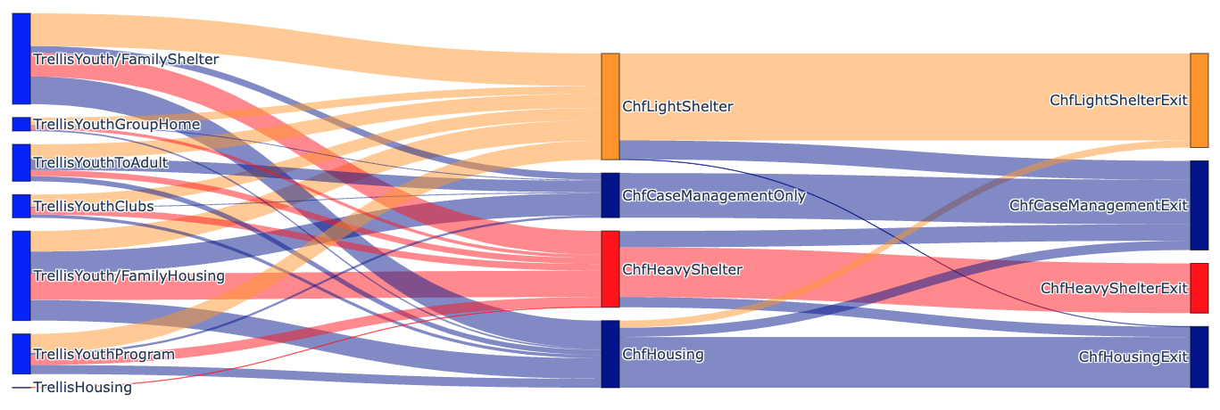
Case Study 2: Record Linkage
88% of the youth involved with Trellis did not appear in the adult housing/homelessness system.
The 12% who did followed these paths:

Slide 20
Ethics of Using AI
Data Questions:
Are the people you are trying to help well represented in the data used to train your AI?
Does your use of the data reflect the wishes of the people in the data?
Technology Questions:
Is an AI tool compatible with your data IT systems?
Do you have staff expertise to understand and maintain the AI tool?
Do you have processes and funding in place to update the AI tool as data changes over time?

Slide 21
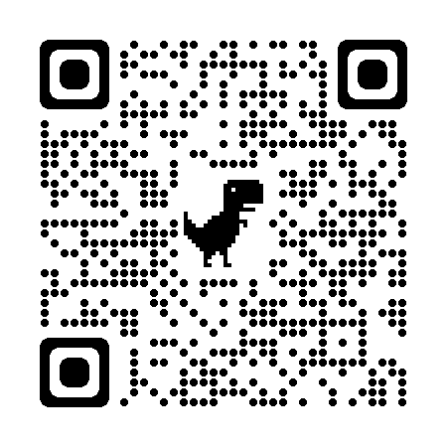
Conclusions
AI can be helpful but it isn’t for everyone.
Investing in people and basic data IT systems is the first (and often last) step.
Happy to chat with you if you’re interested in learning more!
Geoff’s Webpage & Contact Info:

